Slide 1
Being Unshaken in Times of Shaking
Grace Liew
7/10/2018
Notes:
Last Sunday, we heard a message from Uncle Donald on Tell my people I love them and we went through Isa 40 focusing on who God is. When we realise how great God is, everything else pales in insignificance. Our Great God wants us to know how loved and how cared for we are despite what our current experiences might be.
Today, I’d like to share on being unshaken in times of shaking. As we’ll go through this morning, we are living in the last days. In the Daniel class, we established that the last days are right now (they started when Jesus came). Scripture tells us many things about the last days.
So, how do we remain steadfast and unshaken during these times? As was shared last Sunday, when we have a proper perspective of God and we’re clear on who He is, and we have a right attitude towards Him, everything else is rather insignificant in comparison.

Slide 2
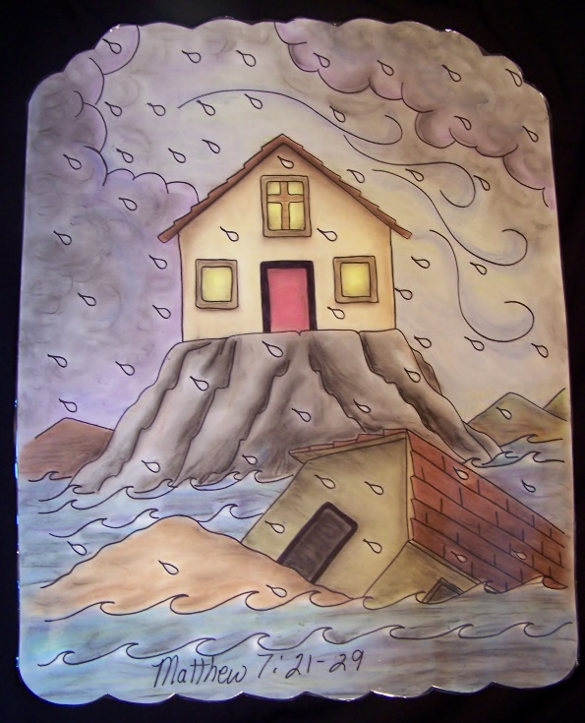
Key Scriptures
Matt 7:24
Therefore whoever
  hears these sayings of Mine, and
  does them,
I will liken him to a wise man
who built his house on the rock: and
  the rain descended,
  the floods came, and
  the winds blew and
  beat on that house; and
  it did not fall,
for it was founded on the rock.

Slide 3
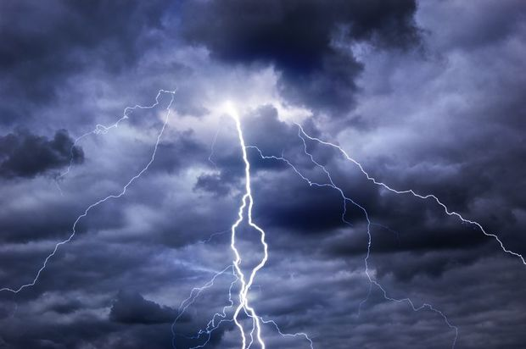
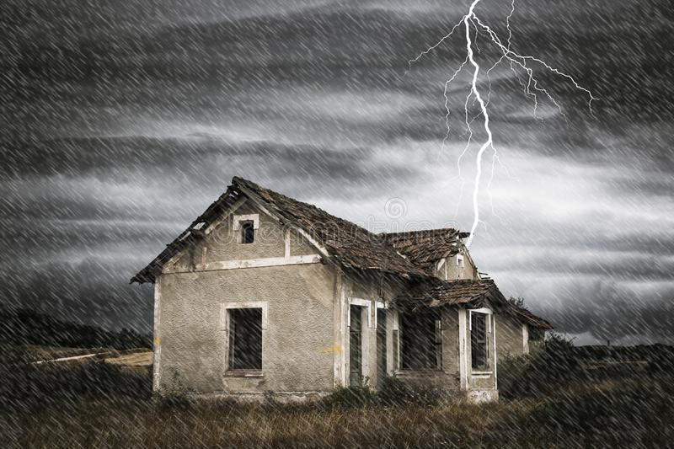
Key Scriptures
Luke 6:48-49
He is like a man building a house,
who dug deep and
laid the foundation on the rock. And when
  the flood arose,
  the stream beat vehemently against that house,
and could not shake it,
for it was founded on the rock.
But he
who heard and
did nothing
is like a man who built a house on the earth
without a foundation, against which
  the stream beat vehemently; and
  immediately it fell.
And the ruin of that house was great.

Slide 4
Key Scriptures
Ps 111:10
The fear of the Lord is the beginning of wisdom; A good understanding have all those who do His commandments. His praise endures forever.
Ps 112
Praise the Lord!
Blessed is the man who fears the Lord,
Who delights greatly in His commandments.

Slide 5
Key Scriptures
Ps 112 cont’d
Rewards:
His descendants will be mighty on earth;
The generation of the upright will be blessed.
Wealth and riches will be in his house,
And his righteousness endures forever.
Unto the upright there arises light in the darkness;
He is gracious, and full of compassion, and righteous.

Slide 6
Key Scriptures
Ps 112 cont’d
A good man
Deals graciously and lends;
He will guide his affairs with discretion.
Surely he will never be shaken;
The righteous will be in everlasting remembrance.
He will not be afraid of evil tidings;
His heart is steadfast, trusting in the Lord.
His heart is established;
He will not be afraid,
Until he sees his desire upon his enemies.

Slide 7
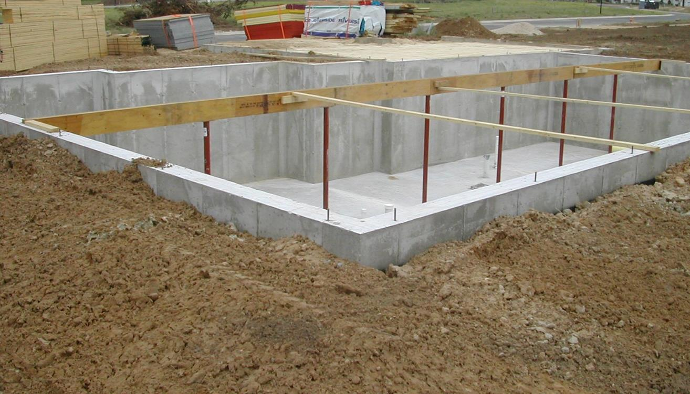
FOUNDATION
Psalm 112
Never be shaken
His heart is steadfast
His heart is established
He will not be afraid.
Notes:
Introduction
We’re spending a lot of time talking about foundation – the advanced class on Sunday afternoons, Life group lessons with Derek Prince, we’ve covered material before in life groups and other classes.
Let’s get this out there. Times of testing will come. It’s not a question of if but rather when. So when they come, how will we fare?
Psalms 111-112 provides a description of a man who fears the Lord which leads to doing His commandments, what his rewards are (the blessings that he receives as a result) etc.
Amongst all those blessings, it describes him as
Never be shaken
His heart is steadfast
His heart is established
He will not be afraid.

Slide 8

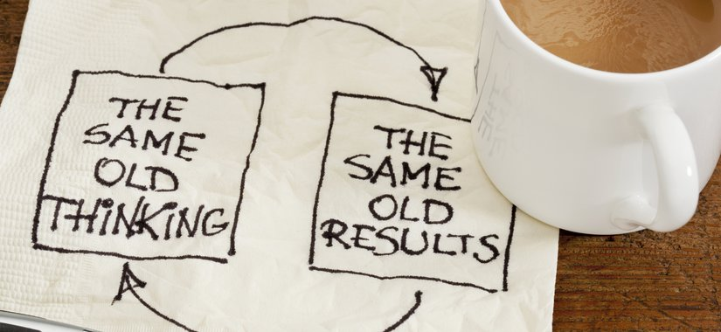
A person’s philosophy determines their beliefs
A person’s belief determines their attitudes
A person’s attitude determines their behaviour
A person’s behaviour determines their character
A person’s character determines their DESTINY
- Kevin J Conner
Notes:
In our SOAP reading (1 Samuel), we have an interesting comparison between Saul and David that gives us a real life picture of what it means to be unshakeable in times of shaking. We will take some time to study these two and look into their attitudes, their behaviours and their destinies.
A person’s philosophy determines their beliefs
A person’s belief determines their attitudes
A person’s attitude determines their behaviour
A person’s behaviour determines their character
A person’s character determines their DESTINY
We all want to have great futures and destinies but it all starts with our philosophy / beliefs. What we think determines our outcome.

Slide 9
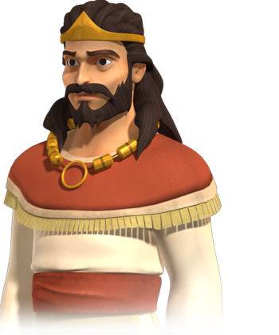
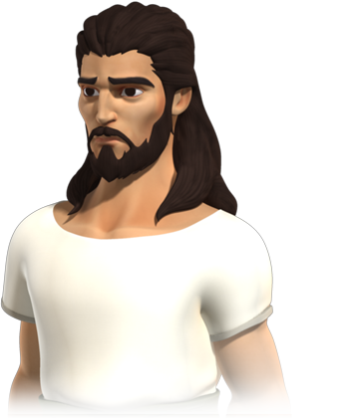

The difference between
Saul and David
B LAME
E XCUSES
D ENIAL
Notes:
As we look into the lives of Saul and David. You will notice a very big difference between their beliefs, attitudes, behaviours, character and resulting destiny. An acronym that has been helpful to me and countless others.
Blame – If she didn’t do this, They did this, (shifting the responsibility to someone else)
Excuses – If only I had more time, (a reason to justify my actions)
Denial – I didn’t do that, it never happened, I never said that, (refusal to admit the truth)

Slide 10
Saul – Israel’s first king
Feared man instead of God
  Relied on man instead of God
  Looked for approval and validation from man
  Didn’t seek God first
Overcompensated guilt
  By being religious (making rash vows)
Became proud
Rejected the word of the Lord

Slide 11
Saul – Feared man instead of God
1 Sam 13 Quick facts:
Newly appointed king (had only reigned two years).
He decides to gather together an army of 3,000 men to fight the Philistines.
Jonathan takes out a garrison (strategic fort) and Israel is called to Gilgal.
Philistines respond by bringing out their army. Israelites outnumbered 12:1 (3,000 vs 36,000).
Saul and the Israelites wait at Gilgal for Samuel to come and offer sacrifices
Their victory is eclipsed by impending danger; the odds are stacked against them
Saul becomes impatient and offers the sacrifices instead.
Notes:
1 Sam 13 – When he conducted the sacrifice
Newly appointed king (had only reigned two years). He decides to gather together an army of 3,000 men to fight the Philistines. Jonathan takes out a garrison (strategic fort) and Israel is called to Gilgal. Meanwhile, the Philistines respond by bringing out their army which effectively has the Israelites outnumbered 12:1 (3,000 vs 36,000). It is while the Israelites are gathering at Gilgal that Saul waits for Samuel to come to offer sacrifices. Their victory is eclipsed by impending danger as they are acutely aware that the Philistines outnumber them and the odds are stacked against them (the Philistines controlled weapons manufacturing. Imagine the only factory that makes swords, shields etc was in a different country). v6 says that the people were so afraid that they hid in caves, bushes, rocks, pits and v7 says they were trembling. Waiting for Samuel seemed like forever. V8 says that Saul waited for 7 days as instructed by Samuel by the time, the people started to scatter. Saul takes matters into his own hands because he can’t wait any longer and offers the sacrifice himself. While this may seem like an efficient thing to do and an action that would cement his leadership (so that others would view him as decisive and taking charge), instead, it draws criticism from the prophet Samuel. Why have you done this? This moment becomes a decisive moment in Saul’s life where Samuel states that instead of this being the moment that God establishes Saul’s kingship, instead, God has found someone else to take the throne. Someone after His own heart.

Slide 12

Saul – Feared man instead of God
v6 The people were so afraid
v7 They were trembling
V8 Saul waited (7 days); the people started to scatter.
Why did Saul feel the need to offer the sacrifice himself?
What was Saul’s response?
Blame – you didn’t come on time
Excuses – the people were scattered from me
Notes:
v6 says that the people were so afraid that they hid in caves, bushes, rocks, pits and v7 says they were trembling. Waiting for Samuel seemed like forever. V8 says that Saul waited for 7 days as instructed by Samuel by the time, the people started to scatter. Saul takes matters into his own hands because he can’t wait any longer and offers the sacrifice himself. While this may seem like an efficient thing to do and an action that would cement his leadership (so that others would view him as decisive and taking charge), instead, it draws criticism from the prophet Samuel. Why have you done this? This moment becomes a decisive moment in Saul’s life where Samuel states that instead of this being the moment that God establishes Saul’s kingship, instead, God has found someone else to take the throne. Someone after His own heart.
Why such a harsh punishment for one failure? ANSWER: Saul knew that he was not to offer the sacrifice himself. It wasn’t a new law or rule. It has been established throughout the generations that only priests could offer sacrifices.
What was Saul’s response? (Blame – you didn’t come on time and Excuses – the people were scattered from me)
In chapter 14, we see an interesting response from Saul. Fresh from a harsh word from Samuel, Saul orders the Israelite army to fast (1 Sam 14:24). Failure to comply resulting in death. Sometimes, when confronted with the truth or a “hard word”, instead of repenting, we overcompensate. To offset the guilt or the sin, we become religious. Saul made a vow to fast – appearing to be religious and forced his army to do so too. What was the vow for? Was it necessary?

Slide 13
Saul – Pride crept in
1 Sam 15 Quick facts:
Samuel relays very specific instructions to Saul.
He is to utterly destroy the Amalekites v1-3.
This time Saul has a much larger army (210,000).
In this battle, the Israelites were successful.
But instead of following the instructions, King Agag was kept alive v9 – most likely as a trophy
The best of the sheep, oxen, anything deemed “good” was kept.
Gloating in this victory, Saul goes to set up a monument for himself v12.
Notes:
1 Sam 15 – When he failed to utterly destroy the Amalekites as God commanded
Samuel relays very specific instructions to Saul about utterly destroying the Amalekites in v1-3. This time as Saul goes to battle to take down the Amalekites, he has a much larger army. In this battle, the Israelites were successful. But instead of following the instructions, v9 states that the King Agag was kept alive (no doubt as a trophy that Saul could go around parading) and the best of the sheep, oxen, anything that was good was kept. The people were unwilling to utterly destroy what they deemed as good.
Gloating in his victory, the first thing Saul does is to set up a monument for himself (v12).

Slide 14
Saul – pride crept in
When Samuel comes to see Saul, what was Saul’s response?
I have kept the commandment of the Lord v13
The people spared the best of the sheep and oxen v15
But I have obeyed the voice of the Lord v20
But the people took the plunder v21
DENIAL
BLAME
DENIAL
BLAME
Notes:
When Samuel comes onto the scene, what was Saul’s response?
Saul confidently states:
I have kept the commandment of the Lord v13 (denial)
The people spared the best of the sheep and oxen v15 (blame)
But I have obeyed the voice of the Lord v20 (denial)
But the people took the plunder v21 (blame)

Slide 15
Saul – Pride crept in
So Samuel said, “When you were little in your own eyes, were you not head of the tribes of Israel? And did not the Lord anoint you king over Israel?
Has the Lord as great delight in burnt offerings and sacrifices, As in obeying the voice of the Lord?
Behold, to obey is better than sacrifice,
And to heed than the fat of rams.
For rebellion is as the sin of witchcraft,
And stubbornness is as iniquity and idolatry.
Because you have rejected the word of the Lord,
He also has rejected you from being king.”
Notes:
Now, the word of the Lord to Saul through Samuel is much stronger. V22-23
“Has the Lord as great delight in burnt offerings and sacrifices, As in obeying the voice of the Lord? Behold, to obey is better than sacrifice, And to heed than the fat of rams. ²³ For rebellion is as the sin of ^{[d]}witchcraft, And stubbornness is as iniquity and idolatry. Because you have rejected the word of the Lord, He also has rejected you from being king.”
In his own admission, Saul made a last minute attempt to repent saying that it was his fear of others. Fear of not being approved, fear of not being liked, fear of not being validated by the people that drove him to do what he did.
V23, 26 Because you have rejected the word of the Lord, therefore He is rejecting you
V30 demonstrates that Saul still values mans opinion by asking Samuel to “give him face”.

Slide 16
Saul – It’s too late
1 Sam 28 Quick facts:
Samuel has passed away
Saul is approaching another battle with the Philistine
He now decides to seek God
God has already removed His Spirit from Saul and Saul knew it
It was too late, his destiny was sealed
Notes:
1 Sam 28 – The consequences of a man who did not fear the Lord (but feared man instead)
In the final few chapters of 1 Sam, we see that Samuel has passed away and Saul is approaching another battle with the Philistines. It isn’t his final battle but he is so nervous, he now decides to consult God. By this time, God had removed His Spirit from Saul and Saul knew it. He tried desperately to seek God for guidance but to no avail.
V5 he was afraid and his heart trembled greatly.
V20 he was dreadfully afraid
But it was too late, his destiny was sealed. In Chapter 31, in the midst of battle whilst wounded, he committed suicide to avoid the pain / suffering and humiliation of being captured by his enemies.

Slide 17
David – A man after God’s heart
The Lord looks at the heart 1 Sam 16:7
Always sought the Lord first
Cared about the things of God
Didn’t care what others thought of him
Quick to repent
Humble
Notes:
David – Now looking at David. By no means perfect. But was described as a man after God’s own heart. David faced very challenging situations but made it through because he placed his hope in God (Isa 40)
V7 The Lord looks at the heart

Slide 18
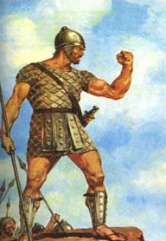
David – Courageous
1 Sam 17 Quick facts:
Philistines taunting the Israelites (40 days).
Goliath the giant and weapon
The people were dismayed, greatly afraid and dreadfully afraid v11, 24
Notes:
1 Sam 17 – Fearlessly went after a giant in the name of his God!
V11, 24 Whilst Saul and others were dismayed, greatly afraid and dreadfully afraid
What was David’s response?
Who is this uncircumcised Philistine that he should defy the armies of the living God? V26, 36
Is there not a cause? V29
I come to you in the name of the Lord of Hosts, the God of the armies of Israel whom you have defied v45
This day the Lord will deliver you into my hand … v46
For the battle is the Lord’s v47

Slide 19
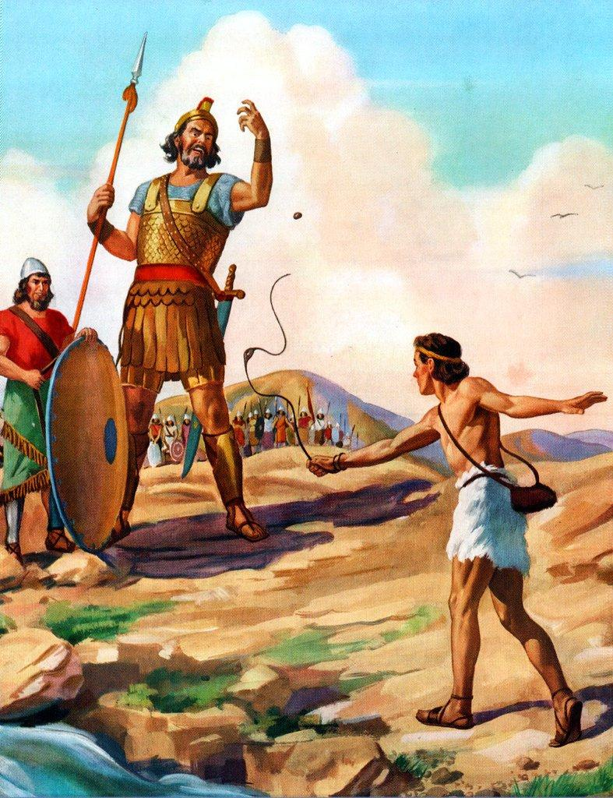
David - Courageous
What was David’s response?
Who is this uncircumcised Philistine that he should defy the armies of the living God? v26, 36
Is there not a cause? v29
I come to you in the name of the Lord of Hosts, the God of the armies of Israel whom you have defied v45
This day the Lord will deliver you into my hand … v46
For the battle is the Lord’s v47
Notes:
What was David’s response?
Who is this uncircumcised Philistine that he should defy the armies of the living God? V26, 36
Is there not a cause? V29
I come to you in the name of the Lord of Hosts, the God of the armies of Israel whom you have defied v45
This day the Lord will deliver you into my hand … v46
For the battle is the Lord’s v47

Slide 20
David - Unshaken
1 Sam 30 Quick facts:
David is still on the run from Saul
Given a city to live in – Ziklag
Amalekites come, set the city on fire, raid the city and take the women and children captives
When David and the men discover what has happened, they wept
The men were so distraught, they spoke of stoning David
Notes:
1 Sam 30 – Recover all!
Fast forward to chapter 30, David is still on the run from Saul. He has been given a city to live in – Ziklag. One day, the Amalekites come, set the city on fire, raid the place and take captive the wives and children (of David and his men). This is a pretty dire situation. Unlike Saul’s situation where the people were getting impatient and decided to leave Gilgal, here we have David’s men who have lost their families. They are talking about stoning him v6.
Instead of taking matters into his own hands and doing what he wasn’t supposed to do…
What was David’s response?
Blame? Excuses? Denial?
No. Despite being greatly distressed (v6), he strengthens himself in God through the priest, enquires of the Lord. He asks God for direction v8 – Shall I pursue? He gets a clear response from God – YES!
And so David went (v9), pursued (v10), attached (v17), recovered (v18), rescued (v18). V19 David recovered all.
What could have ended up being a very serious and life-threatening situation was diffused because David turned to the Lord for direction.
Being unshakeable in times of shaking and to use bible terms – great distress.

Slide 21
David - Unshaken
What was David’s response?
Blame? Excuses? Denial?
David strengthened himself in God v6
David sought the Lord for direction v8
David received clear instructions v8
David went v9
David pursued v10
David attacked v17
David recovered all v18, 19
Notes:
What was David’s response?
Blame? Excuses? Denial?
No. Despite being greatly distressed (v6), he strengthens himself in God through the priest, enquires of the Lord. He asks God for direction v8 – Shall I pursue? He gets a clear response from God – YES!
And so David went (v9), pursued (v10), attached (v17), recovered (v18), rescued (v18). V19 David recovered all.
What could have ended up being a very serious and life-threatening situation was diffused because David turned to the Lord for direction.
Being unshakeable in times of shaking and to use bible terms – great distress.

Slide 22
The difference between
Saul and David
The fear of the Lord
Ps 112

Slide 23
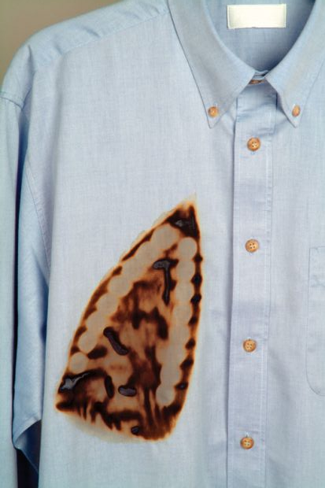
In the last days…
1 Tim 4:1-4 Now the Spirit expressly says that in latter times some will
Depart from the faith,
Giving heed to deceiving spirits and doctrines of demons,
Speaking lies in hypocrisy,
Having their own conscience seared with a hot iron,
Notes:
So what?
1 Chron 12:32 Of the sons of Issachar who had understanding of the times, to know what Israel ought to do,
The times that we are living in (if you’ve been attending Daniel classes) are the last days. We are living in the present evil age, the last days.
1 Tim 4:1-4 Now the Spirit ^{[a]}expressly says that in latter times some will depart from the faith, giving heed to deceiving spirits and doctrines of demons, 2 speaking lies in hypocrisy, having their own conscience seared with a hot iron,
2 Tim 4:3-4 For the time will come when they will not endure sound doctrine, but according to their own desires, because they have itching ears, they will heap up for themselves teachers; 4 and they will turn their ears away from the truth, and be turned aside to fables.
Our Foundation must be in Jesus Christ alone. There can be no mixture. There is no room for more than one thing. We cannot rely on God and myself, or God and job, or God and …
Daniel was a man that was unshaken and unchangeable in very challenging times.
Dan 6:10 Now when Daniel knew that the writing was signed, he went home. And in his upper room, with his windows open toward Jerusalem, he knelt down on his knees three times that day, and prayed and gave thanks before his God, as was his custom since early days.
Daniel never wavered despite knowing exactly what the consequences would be.
Dan 12:30, Rev 12:11, Rom 12:1-2

Slide 24

In the last days…
2 Tim 4:3-4 For the time will come when
They will not endure sound doctrine, but according to their own desires, because
They have itching ears,
They will heap up for themselves teachers; and
They will turn their ears away from the truth, and
Be turned aside to fables.
Notes:
So what?
1 Chron 12:32 Of the sons of Issachar who had understanding of the times, to know what Israel ought to do,
The times that we are living in (if you’ve been attending Daniel classes) are the last days. We are living in the present evil age, the last days.
1 Tim 4:1-4 Now the Spirit ^{[a]}expressly says that in latter times some will depart from the faith, giving heed to deceiving spirits and doctrines of demons, 2 speaking lies in hypocrisy, having their own conscience seared with a hot iron,
2 Tim 4:3-4 For the time will come when they will not endure sound doctrine, but according to their own desires, because they have itching ears, they will heap up for themselves teachers; 4 and they will turn their ears away from the truth, and be turned aside to fables.
Our Foundation must be in Jesus Christ alone. There can be no mixture. There is no room for more than one thing. We cannot rely on God and myself, or God and job, or God and …
Daniel was a man that was unshaken and unchangeable in very challenging times.
Dan 6:10 Now when Daniel knew that the writing was signed, he went home. And in his upper room, with his windows open toward Jerusalem, he knelt down on his knees three times that day, and prayed and gave thanks before his God, as was his custom since early days.
Daniel never wavered despite knowing exactly what the consequences would be.
Dan 12:30, Rev 12:11, Rom 12:1-2

Slide 25
Conclusion
Luke 6:48 He is like a man building a house, who dug deep and laid the foundation on the rock. And when the flood arose, the stream beat vehemently against that house, and could not shake it, for it was founded on the rock.
1 Cor 15:58 Therefore, my beloved brethren, be steadfast, immovable, always abounding in the work of the Lord, knowing that your labor is not in vain in the Lord.
Notes:
Luke 6:48 He is like a man building a house, who dug deep and laid the foundation on the rock. And when the flood arose, the stream beat vehemently against that house, and could not shake it, for it was ^{[a]}founded on the rock.
1 Cor 15:58 Therefore, my beloved brethren, be steadfast, immovable, always abounding in the work of the Lord, knowing that your labor is not in vain in the Lord.

Slide 26

Being unshaken in times of shaking
Notes:
Our Foundation must be in Jesus Christ alone. There can be no mixture. There is no room for more than one thing. We cannot rely on God and myself, or God and job, or God and …
Daniel was a man that was unshaken and unchangeable in very challenging times.
Dan 6:10 Now when Daniel knew that the writing was signed, he went home. And in his upper room, with his windows open toward Jerusalem, he knelt down on his knees three times that day, and prayed and gave thanks before his God, as was his custom since early days.
Daniel never wavered despite knowing exactly what the consequences would be.
Dan 12:30, Rev 12:11, Rom 12:1-2
Closing:
Luke 6:48 He is like a man building a house, who dug deep and laid the foundation on the rock. And when the flood arose, the stream beat vehemently against that house, and could not shake it, for it was ^{[a]}founded on the rock.
1 Cor 15:58 Therefore, my beloved brethren, be steadfast, immovable, always abounding in the work of the Lord, knowing that your labor is not in vain in the Lord.

